Slide 1
Mission Impossible
（Really impossible！！！）
Team Members:
Secretary: Yilin Zhang; Source Management: Dier Hou; Style: Wentao Xu, Chenhao Zheng;
Requirements: ZhouWei; Testins: Yuxiang

Slide 2
This is a really tough game
Designed and devoted by a player in the game “Break Out and Attack”（《突出重围：出击》in Chinese）
Found, redesigned and implemented by a group of students(which is us!)
Really impressive!

Slide 3
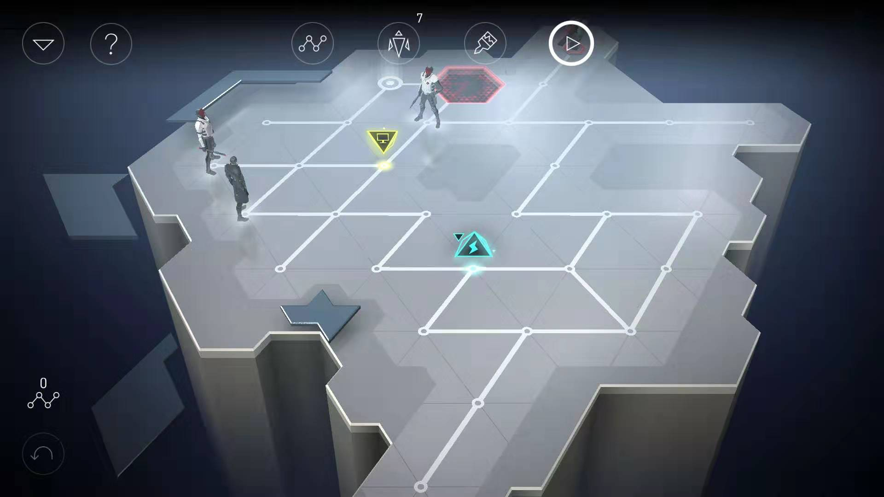
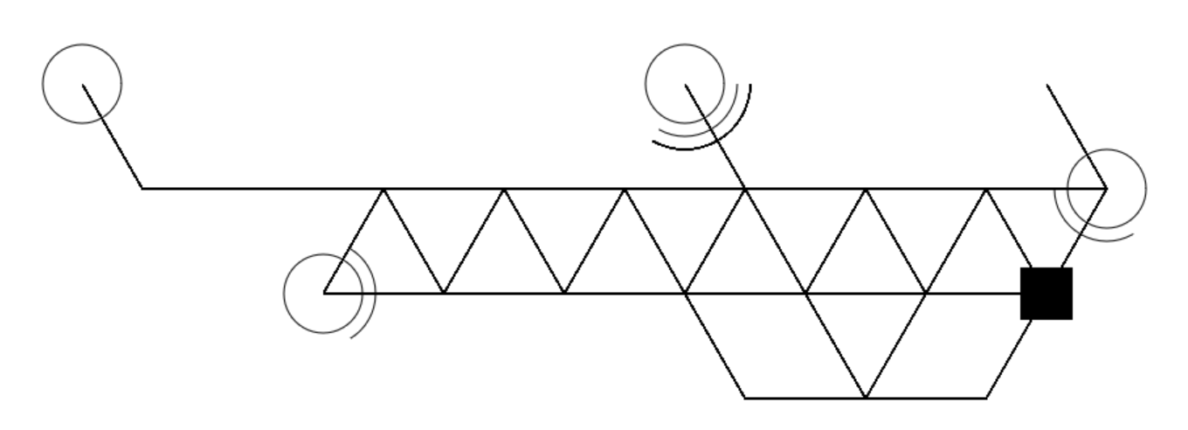
Quite Abstrct

Slide 4
First let us tell everyone :
Our goal and each one’s role in this game!

Slide 5
Structural design
Good Design
=
Good Cooperation

Slide 6
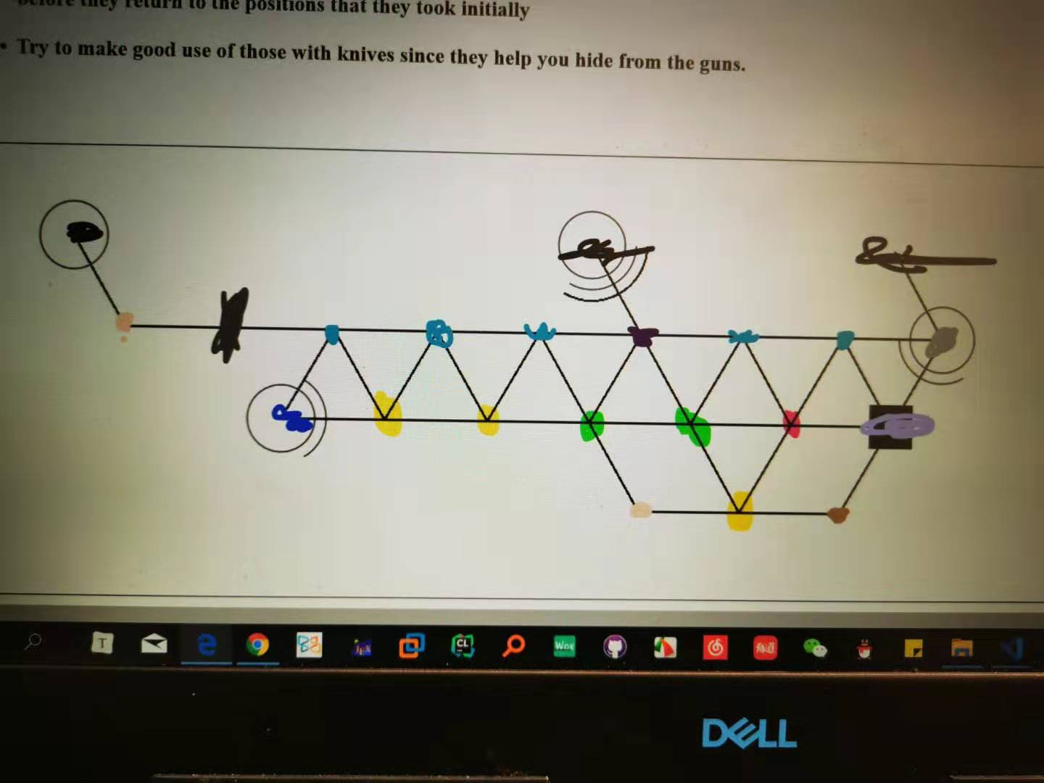
Player Movement

Slide 7
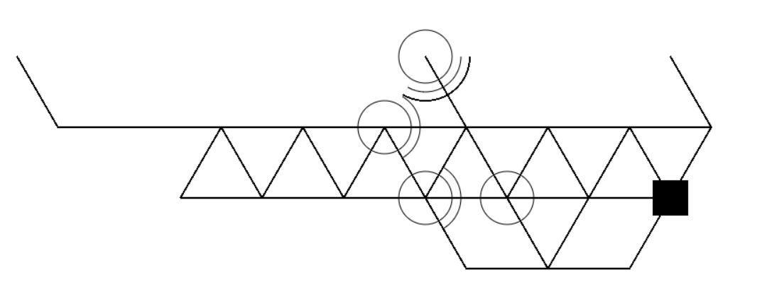
How the GUN works

Slide 8
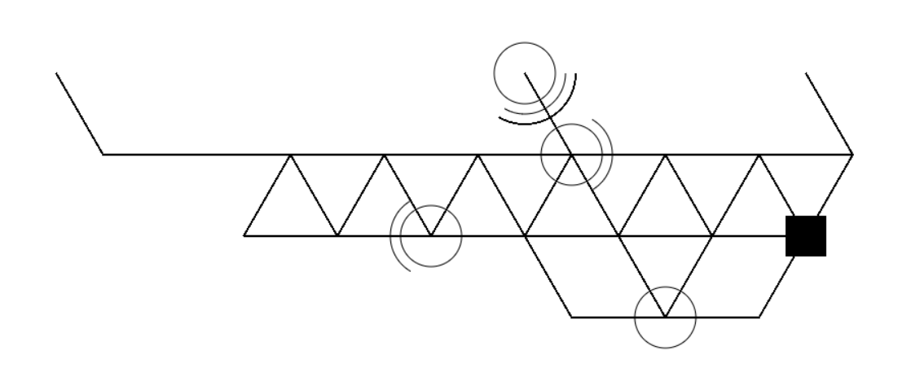
How the GUN works

Slide 9
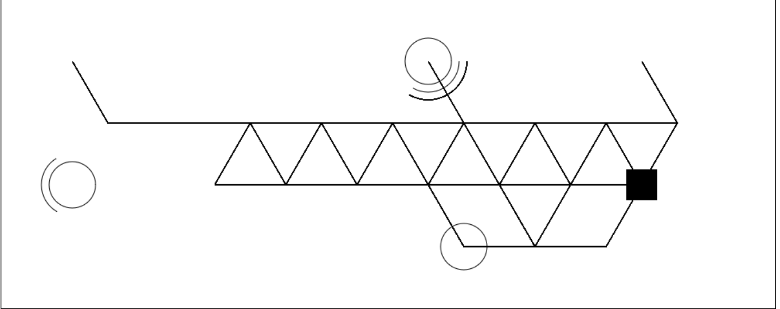
Debugs

Slide 10
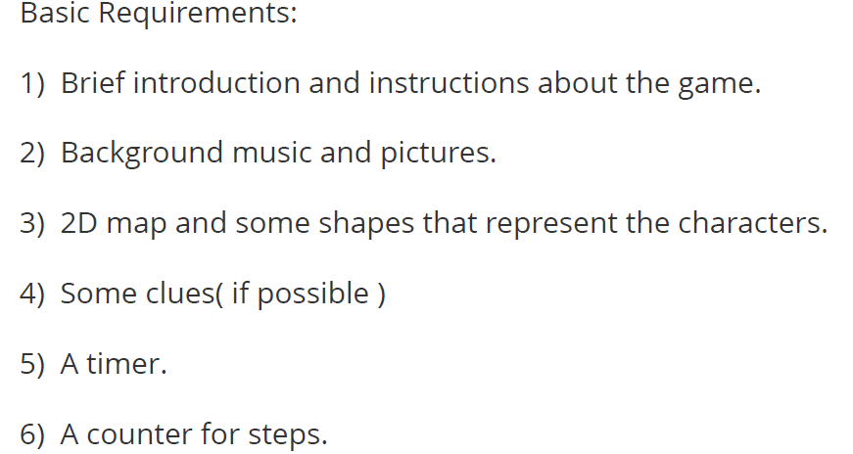
Requirements

Slide 11
Second let us tell everyone :
How to
play the game!

Slide 12
Third let us show you how to win:
Just Joking, Try it out yourself!

Slide 13
Thanks for watching! Thanks for your time!

